Slide 1

Data selection
week6

Slide 2
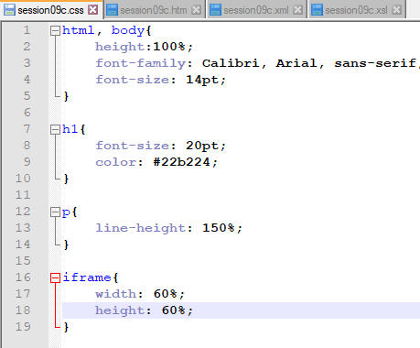
Create css

Slide 3
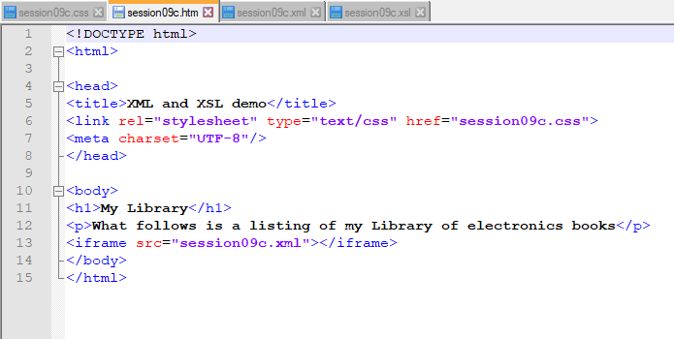
Create htm page

Slide 4
Time to explain difference between htm and html
.htm files serve the same purpose as .html files.
.html file extension was the original file extension for HTML pages running on Unix web servers. ...
The only difference between the two is that:
.htm is used as an alternate to .html by few servers that do not accept four character extensions.

Slide 5
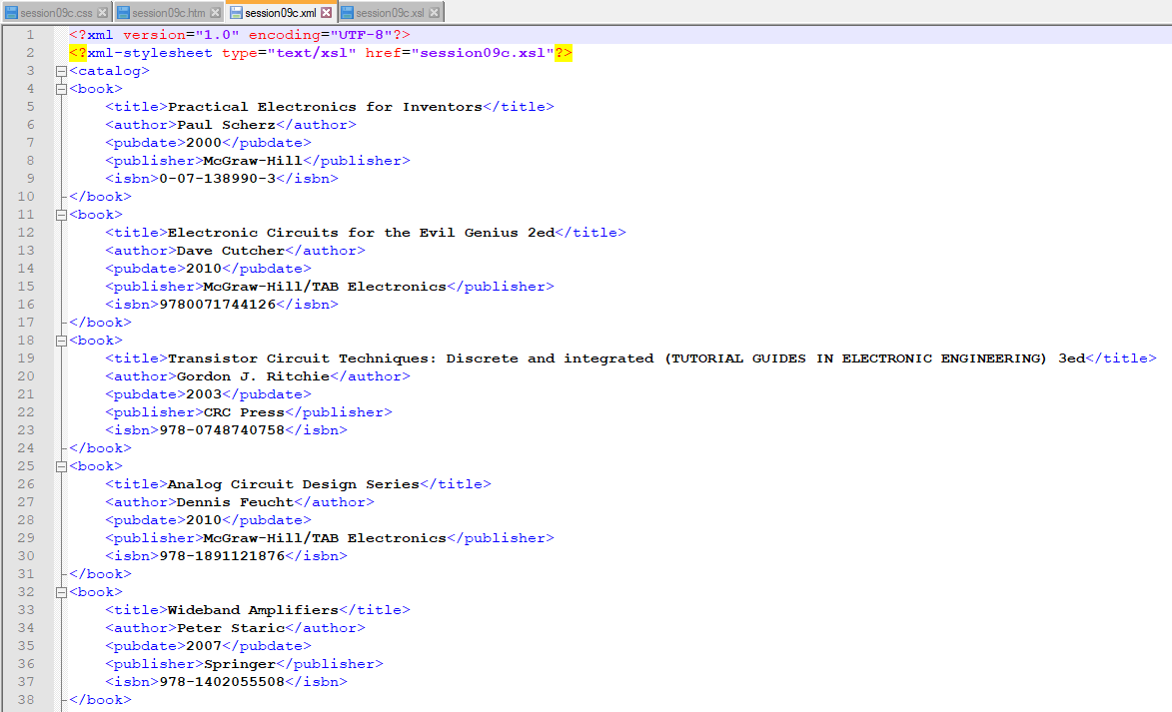

Slide 6
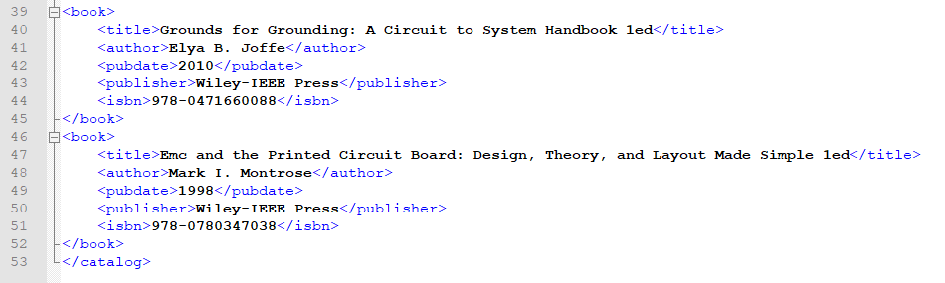

Slide 7
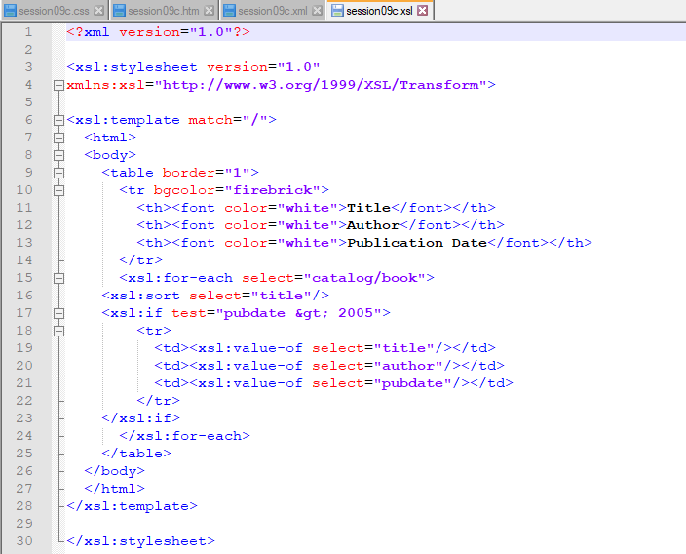
And our stylesheet
select=“catalog/book[publisher=‘McGraw-Hill’] “>

Slide 8

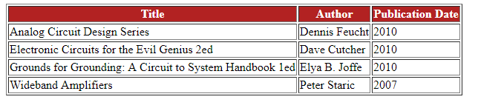
Run it:
(YOUR PATH MAY BE DIFFERENT)

